Slide 1
Photo Booth Rentals in Los Angeles
https://sites.google.com/view/beverly-hills-video-booth-rent/home
Notes:
https://sites.google.com/view/beverly-hills-video-booth-rent/home
https://drive.google.com/drive/folders/1ltf6BK838aoBdT1iFEq-nkSKHQnfTMxc?usp=sharing
https://news.google.com/rss/search?q=videobooth
https://drive.google.com/drive/folders/1Hq3Gfp9GVO3jYIpvrrtMIjHyFAI4ryTz?usp=sharing
https://drive.google.com/drive/folders/18ntyVtB43QGqzLYoqa8WEjyAJCuNCGya?usp=sharing
https://drive.google.com/drive/folders/1vxC8zpxKzwSQasarZOQkWRRuWdgQ4grN?usp=sharing
https://drive.google.com/drive/folders/1T6ypQixhjlsJQfpuTczF4Ip3Lvpz4AjF?usp=sharing
https://drive.google.com/file/d/1ZC83rHwcmG1qM8c9i34hNF5jHCkGZEOG/view?usp=sharing
https://drive.google.com/file/d/1EOa9-xoFKVwc4-VmWjZPWjVVe27CYzzc/view?usp=sharing
https://drive.google.com/file/d/140vDlT7WZfFAJAS0k5WdWn2TxHGW9blj/view?usp=sharing
https://drive.google.com/file/d/1vakeA2I0uEvUGFvWsFWBDIo_orvN4zmx/view?usp=sharing
https://docs.google.com/spreadsheets/d/1OnP-cjln-pnD5nAOrvZi9A6EhA_nBsr6YTLX7sb9rbQ/edit?usp=sharing
https://docs.google.com/spreadsheet/pub?key=1OnP-cjln-pnD5nAOrvZi9A6EhA_nBsr6YTLX7sb9rbQ
https://docs.google.com/spreadsheets/d/1OnP-cjln-pnD5nAOrvZi9A6EhA_nBsr6YTLX7sb9rbQ/pubhtml
https://docs.google.com/spreadsheets/d/1OnP-cjln-pnD5nAOrvZi9A6EhA_nBsr6YTLX7sb9rbQ/pub
https://docs.google.com/spreadsheets/d/1OnP-cjln-pnD5nAOrvZi9A6EhA_nBsr6YTLX7sb9rbQ/view
https://docs.google.com/forms/d/1oVCl_IHkVaurI-q17wzSWrq_Cp7U5EnrDYKRfrVMdUc/edit?usp=sharing
https://docs.google.com/drawings/d/1aS73yc5AcgcT2hs5uRcgb01D_WmL3xYrzDhGTlPEKIE/edit?usp=sharing
https://drive.google.com/file/d/1tpnxuW89TUi11jKtDR9JDr08CDxHmMk0/view?usp=drivesdk
https://sites.google.com/view/roamingphotoboothrentla/home
https://docs.google.com/document/d/1RtrvhZZeFKpOxfODbbqAd2H1Aw2mngMaEeARXJ3qAkU/edit?usp=sharing
https://docs.google.com/document/d/1RtrvhZZeFKpOxfODbbqAd2H1Aw2mngMaEeARXJ3qAkU/pub
https://docs.google.com/document/d/1RtrvhZZeFKpOxfODbbqAd2H1Aw2mngMaEeARXJ3qAkU/view
https://docs.google.com/presentation/d/1bct4Nl5WoCUQLcgXBrvP2-S52tDAH0j_Z-ZJ0zWvPAI/edit?usp=sharing
https://docs.google.com/presentation/d/1bct4Nl5WoCUQLcgXBrvP2-S52tDAH0j_Z-ZJ0zWvPAI/pub?start=true&loop=true&delayms=3000
https://docs.google.com/presentation/d/1bct4Nl5WoCUQLcgXBrvP2-S52tDAH0j_Z-ZJ0zWvPAI/view
https://docs.google.com/presentation/d/1bct4Nl5WoCUQLcgXBrvP2-S52tDAH0j_Z-ZJ0zWvPAI/htmlpresent

Slide 2
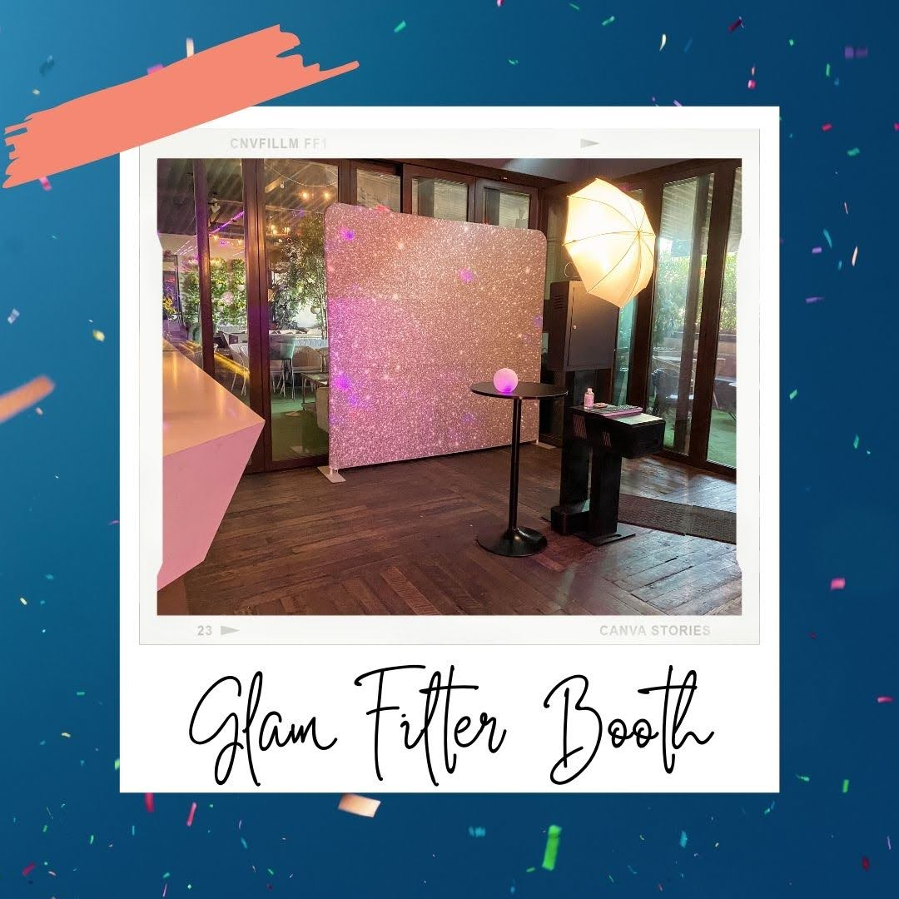

Slide 3
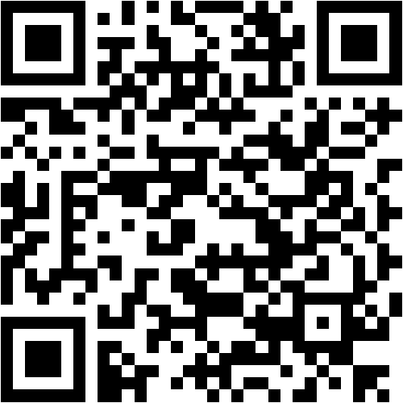

Slide 4
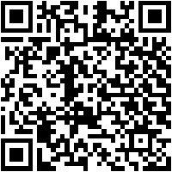
Photo Booth Rentals in Los Angeles
lucky Frog video booth rentals are the perfect party rental for your endearing 16 or Quinceanera. {} We pay for the most Unique and Fun Photo Booth Rental, we manage to pay for utility {} for parties, weddings, and happenings on the subject of the Long beach area.&nbsp;Long beach is a unique and busy city, subsequently an urban downtown, laid put up to quay and the local hang-out spot at Belmont Shore. Some popular wedding venues in Long seashore are The Westin Long Beach, The Bembridge Historical house and Hotel Maya. A visit to Long seashore is not resolution following a vacation to the Aquarium of the Pacific to play taking into consideration some sealife, or exploring The Queen Mary. Long seashore is centrally located and is just a sharp car ride away from San Pedro, Los Alamitos, Anaheim, Seal beach and Huntington Beach.&nbsp;World renowned Laguna seashore offers some of the best issue venues in all of Southern California. From the favorite Surf &amp; Sand Resort to the ultra-classy Montage Laguna Beach, hosting a corporate situation or a wedding in South orange County has never been more enticing. Laguna beach is in a unique location, just a rude trip away from genial cities of Aliso Viejo, Laguna Niguel, Laguna Hills, Dana Point, San Juan Capistrano, Mission Viejo, Lake Forest, Newport Beach, Irvine, Costa Mesa, Rancho Santa Margarita, San Clemente, and Tustin just to herald a few. Head to cherish Island beach for lovable beach views, Check out some funky artwork at the Laguna seashore Art Museum, or snap some pictures at the murals on Laguna Canyon RoadFullerton is a laid put up to city subsequently a researcher town vibe, and as well as has some great looking issue venues. The Hangar 21 South venue at the Fullerton Municipal airport is always a great option to host a high-end event. If you plot upon getting married in Fullerton, The Muckenthaler Mansion is a 9 acre masterpiece that will tally up an intimate Garden ceremony, enclosed afterward lush foliage. If you are looking for an intimate accrual reveal in the heart of Downtown Fullerton, then the RSVP business way of being would be an ideal unusual for any Fullerton event. while paying a visit to Fullerton, make definite to check out local attractions bearing in mind the Fullerton Arboretum, just North of the Cal welcome Fullerton Campus. Parking is pardon and they just question for a little donation to enter inside.&nbsp;Nestled in the heart of yellowish-brown County, Anaheim is an all-American city, featuring Dinsleyland, a gruff ride to the orangey County Beaches, a successful foodie scene and some world-class shopping. Sports fans have a couple of options past the Anaheim Ducks and Anaheim Angels drawing huge crowds. Along like lots of tourism options, Anaheim offers some of the best business venues in orange County; the M3 stimulate Anaheim situation center hosts hundreds of happenings a year, The Highway 39 situation center is great for all types of goings-on and The Colony house is great for hosting weddings. Along in imitation of Anaheim, we then give photo booth rentals to to hand Fullerton,Placentia, Garden Grove, Orange, CA. Stanton, Buena Park, Brea, and Yorba Linda.Costa Mesa is known as an artist city, nestled in the heart of orange County. There are many things to do in Costa Mesa, and the city is most known for the South Coast Plaza mall. Along in imitation of shopping, you can check out the many Art Installations along gone funky hipster spots subsequent to The LAB Anti-Mall. The LAB stands for Little American Business, and has many places to eat, shop and enjoy the nice weather in an uncovered mall setting. Costa Mesa is a great place to have a wedding and the stroll &amp; Gardens thing venue is one of the most popular wedding venues in all of Southern California.&nbsp;
Using the gift of protester photography techniques and Photoshop, we create something fun and unique using our Creative Filter Photo Booth rental. It can be programmed into a super booth! Your guests will be surprised subsequent to our filters, including popular filters later than Anaglyph, CYMK, Glam, and more. Our Creative Filter Photo Booth Rentals come up with the money for a fun photo booth experience similar to awesome filters, including well-liked filters next Anaglyph, CYMK, GLAM and many more. Our creative filter photo booths are classy and easy to use, making your guests mood bearing in mind celebrities. Our Hollywood GLAM Photo Booth allows you to overlay images on summit of your guest and create incredible image composites to endure home.
Are you planning an thing and looking to make a unique experience for your guests? complete you desire to host a fun corporate meeting or wedding? Were here to help. Our Creative Filter Photo Booth Rental is the perfect habit to spice things stirring at your adjacent event. Our clean and simple setup ensures that it will fall in with on any feel perfectly.&nbsp;
When you desire a photo booth for your wedding, corporate event, or just to spice happening any event, our Creative Filter Photo Booth is the one. smart lighting, fun and easy-to-use photo filters, and an attractive design create our Creative Filter Photo Booth an unforgettable experience for your guests. taking into account supplementary and carefree filters and materials for your photos, as with ease as professional and friendly keep service, our Creative Filter Photo Booth will come up with the money for your guests something essentially unique to bow to home.&nbsp;The gift of photography techniques and Photoshop is used to create unique and fun images using our Creative Filter photo booth rental. The minimal, clean design of the booth fits in more or less any feel and can be programmed past a variety of filters, including CYMK and Anaglyph. Whether youre planning a wedding or corporate event, we can spice things happening following an awesome photo booth that people will love.We use the faculty of photography techniques along taking into consideration Photoshop to create something unique and fun. Our Creative Filter photo booth rental is tidy and simple, correspondingly it will tie in most events. We with have creative filters behind Anaglyph, CYMK, GLAM, and more. If youre planning your wedding or hosting a corporate event, or just desire to have some fun when associates and family, we would adore to spice things occurring when our Creative Filter Photo Booth Rentals.We create your concern supercharged following our Creative Filter photo booth! We specialize in wedding photography, corporate events, and parties. Our photo booths have enough money fun photo filters that guests of all ages can enjoy. Our creative filter photo booths commandeer memorable moments and offer fun photo filters that guests can put up with home. These photo booths are classy and simple to use, as a result you and your guests will adore creating something in point of fact unique.&nbsp;
When planning an event, having a photo booth can encourage guests attach and make memories together. Were here to create your thing memorable similar to our Creative Filter Photo Booth Rentals. Our photo booths are a fun, classy way for all ages to create something unique. Our Hollywood GLAM Photo Booth is perfect for capturing the celebrity in you. It overlays images higher than the faces of your guests to make unbelievable image composites that you can undertake house past you.Want to scrap book a photo booth in Los Angeles? There are tons of options and choices, but one of the most popular is an entry let breathe photo booth. By using a tall megapixel camera, a flash and photo booth software, guests can achievement the booth and tolerate a few photos. These photos will next be printed out subsequent to a branded template. A more superior choice is an exclusive-style photo booth.&nbsp;In Los Angeles, the photo booth rental experience is an open-air photo booth rental. The most well-liked thing substitute is an open-air photo booth rental. A photo booth rental uses a high megapixel DSLR camera, a flash and photo booth software to govern the experience. Guests can show the photo booth and it counts beside and takes a few pictures, after that prints them out as soon as a branded template. Looking to rent a photo booth in Los Angeles? fortunate Frog Photo Booth is the best another for your event. We provide open-air photo booth rentals that use a DSLR camera and photo booth software, as without difficulty as white, clean clip photo booth backdrops and minimal props to create a sophisticated, stylish see for your event. later youre looking for a photo booth rental in Los Angeles, there are many options and features to consider. One of the most popular matter options is to scrap book an admittance air photo booth rental. This popular option uses a high-megapixel DSLR camera, a flash, and photo booth software to control the experience. Guests can fake the photo booth, it counts down, and prints out several photos. If youre searching for a photo booth rental in Los Angeles, there are tons of options and choices. A well-liked matter option is to baby book an log on air photo booth rental. An admittance air photo booth rental uses a tall megapixel DSLR camera, a flash, and photo booth software to rule the experience. Guests can pretend the photo booth, it counts next to and takes a few pictures, later prints them out later than a branded template.&nbsp;From old-fashioned photo booth strips, to liberal digital prints, this rental boasts state-of-the-art equipment. The studio is intended to bring out the best in you and your guests. therefore who wouldnt want to rent a photo booth from such a extraordinary establishment?Fancy a snapshot of your friendswith a little Hollywood glitz? Think Kim K, not Bambi. Think Hollywood glamour, not California casual. fortunate Frog Photo Booths are the picture-perfect way to luxe going on any event. Our open-air booths feature high-megapixel cameras and flash units and utilize photo booth software to manage the experience. Guests can feat the booth, it counts by the side of and takes a few pictures, subsequently prints them out afterward a branded template. taking into account you are searching for an open expose photo booth rental in Los Angeles, our Kardashian Photo Booth is an excellent choice. In this additional grow old of wedding trends, the selfie booth is the extra guestbook and a memorable habit to celebrate your wedding. Guests can function the photo booth and allow a series of pictures past a sleek white backdrop. The instant photos are later printed out in various formats and sent to the guest's phones. next searching for a photo booth rental in Los Angeles, there are a number of options and choices. One of the most popular situation options is to tape an gain access to expose photo booth rental. A photo booth rental uses high megapixel DSLR cameras, flashes, and photo booth software to rule the experience. Guests can behave the photo booth, which counts the length of and takes a few pictures. It next prints them out past branded templates. A photo booth rental in LA is a well-liked thing option. If you desire to point of view happening the glamour, its best to lp a exchange style of photo booth. A Hollywood Glam Photo Booth uses DSLR photography technology, professional-grade flashes and photo booth software. The booth comes when a tidy white backdrop and minimal stylish props. The idea is to offer guests a more sophisticated, charming see&nbsp;and thats exactly what they get. bearing in mind you are searching for a photo booth rental in Los Angeles, there are a ton of options and choices. One of the most well-liked matter options is to cassette an way in let breathe photo booth rental. This out of the ordinary uses a tall megapixel DSLR camera, a flash and photo booth software to control the experience. Guests can feat the photo booth, it counts down and takes a few pictures, then prints them out with a branded template.
https://sites.google.com/view/beverly-hills-video-booth-rent/home
Notes:
Photo Booth Rentals in Los Angeles

Slide 5
Contact Information
Party Snaps Photo Booth OC | 360 Photo Booth Rental Orange County
12911 Dungan Ln, Garden Grove, CA 92840
(562) 303-9926
Notes:
Party Snaps Photo Booth OC | 360 Photo Booth Rental Orange County12911 Dungan Ln, Garden Grove, CA 92840(562) 303-9926

Slide 6
More info about us:
Photo Booth Rentals in Los Angeles
Notes:
Party Snaps Photo Booth OC | 360 Photo Booth Rental Orange County12911 Dungan Ln, Garden Grove, CA 92840(562) 303-9926

Slide 7
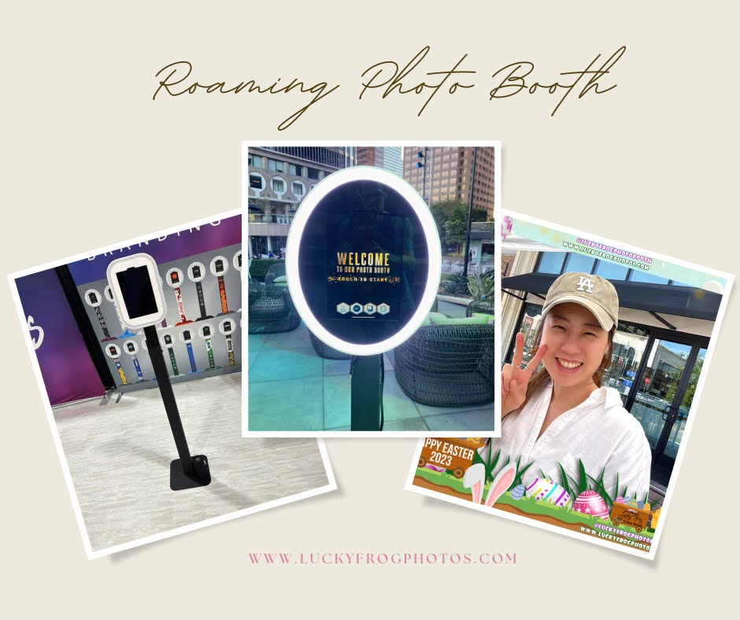

Slide 8
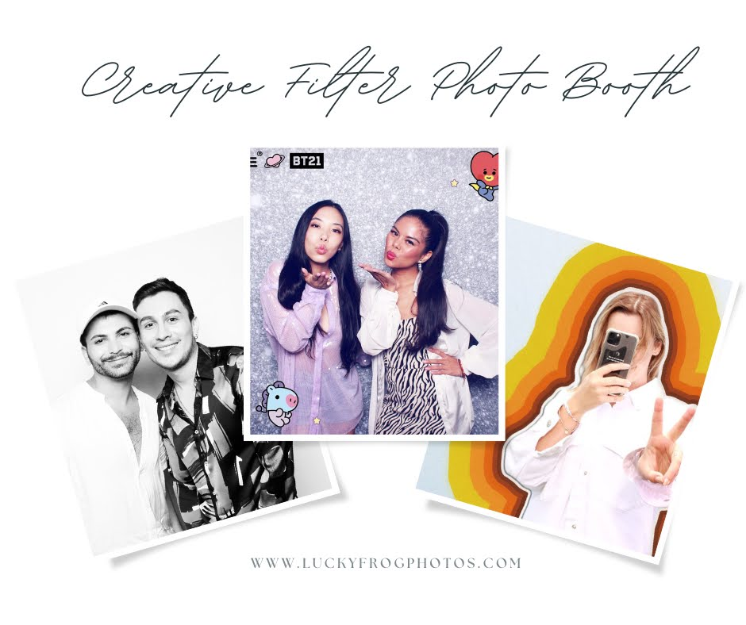

Slide 9
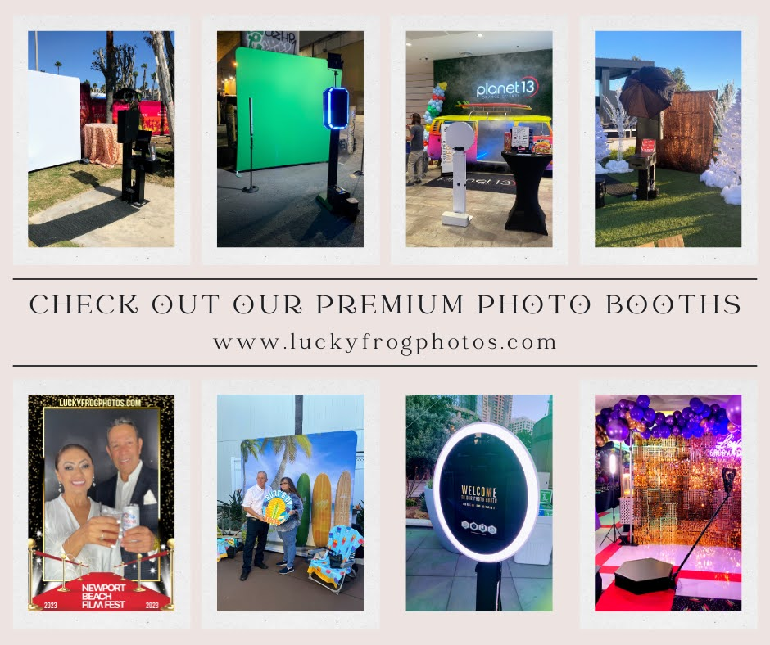

Slide 10
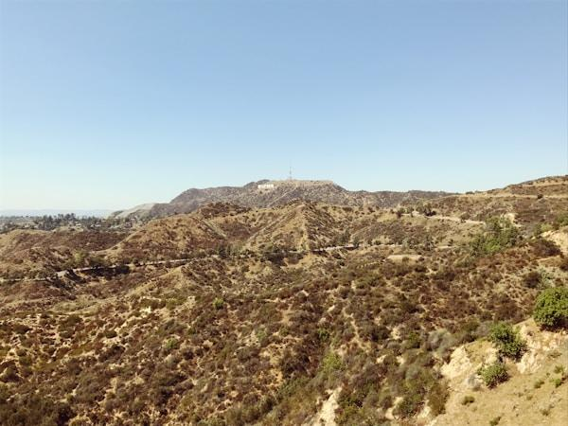

Slide 11
Links
List of recommended resources
Notes:
Photo Booth Rentals in Los Angeles

Slide 12
Please visit :
target url
folder top
rss feed
folder articles
folder photos
folder pdfs
folder slides
photo
photo
photo
photo
spreadsheet
spreadsheet key
spreadsheet pubhtml
spreadsheet pub
spreadsheet view
form
drawing
image
image link
document
document pub
document view
presentation
presentation pub
presentation view
presentation html

Slide 13
Videos
YouTube videos we recommend watching!
Notes:
Photo Booth Rentals in Los Angeles

Slide 14
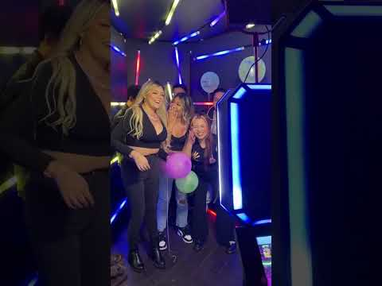
https://sites.google.com/view/beverly-hills-video-booth-rent/home

Slide 15

https://sites.google.com/view/beverly-hills-video-booth-rent/home

Slide 16
https://sites.google.com/view/beverly-hills-video-booth-rent/home

Slide 17

https://sites.google.com/view/beverly-hills-video-booth-rent/home

Slide 18
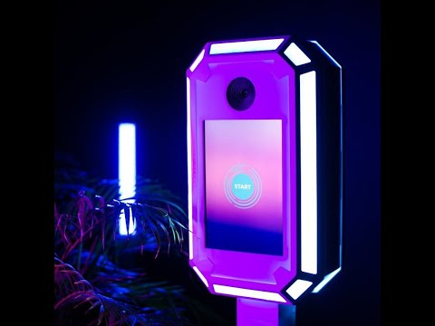
https://sites.google.com/view/beverly-hills-video-booth-rent/home
Notes:
https://sites.google.com/view/beverly-hills-video-booth-rent/home
https://drive.google.com/drive/folders/1ltf6BK838aoBdT1iFEq-nkSKHQnfTMxc?usp=sharing
https://news.google.com/rss/search?q=videobooth
https://drive.google.com/drive/folders/1Hq3Gfp9GVO3jYIpvrrtMIjHyFAI4ryTz?usp=sharing
https://drive.google.com/drive/folders/18ntyVtB43QGqzLYoqa8WEjyAJCuNCGya?usp=sharing
https://drive.google.com/drive/folders/1vxC8zpxKzwSQasarZOQkWRRuWdgQ4grN?usp=sharing
https://drive.google.com/drive/folders/1T6ypQixhjlsJQfpuTczF4Ip3Lvpz4AjF?usp=sharing
https://drive.google.com/file/d/1ZC83rHwcmG1qM8c9i34hNF5jHCkGZEOG/view?usp=sharing
https://drive.google.com/file/d/1EOa9-xoFKVwc4-VmWjZPWjVVe27CYzzc/view?usp=sharing
https://drive.google.com/file/d/140vDlT7WZfFAJAS0k5WdWn2TxHGW9blj/view?usp=sharing
https://drive.google.com/file/d/1vakeA2I0uEvUGFvWsFWBDIo_orvN4zmx/view?usp=sharing
https://docs.google.com/spreadsheets/d/1OnP-cjln-pnD5nAOrvZi9A6EhA_nBsr6YTLX7sb9rbQ/edit?usp=sharing
https://docs.google.com/spreadsheet/pub?key=1OnP-cjln-pnD5nAOrvZi9A6EhA_nBsr6YTLX7sb9rbQ
https://docs.google.com/spreadsheets/d/1OnP-cjln-pnD5nAOrvZi9A6EhA_nBsr6YTLX7sb9rbQ/pubhtml
https://docs.google.com/spreadsheets/d/1OnP-cjln-pnD5nAOrvZi9A6EhA_nBsr6YTLX7sb9rbQ/pub
https://docs.google.com/spreadsheets/d/1OnP-cjln-pnD5nAOrvZi9A6EhA_nBsr6YTLX7sb9rbQ/view
https://docs.google.com/forms/d/1oVCl_IHkVaurI-q17wzSWrq_Cp7U5EnrDYKRfrVMdUc/edit?usp=sharing
https://docs.google.com/drawings/d/1aS73yc5AcgcT2hs5uRcgb01D_WmL3xYrzDhGTlPEKIE/edit?usp=sharing
https://drive.google.com/file/d/1tpnxuW89TUi11jKtDR9JDr08CDxHmMk0/view?usp=drivesdk
https://sites.google.com/view/roamingphotoboothrentla/home
https://docs.google.com/document/d/1RtrvhZZeFKpOxfODbbqAd2H1Aw2mngMaEeARXJ3qAkU/edit?usp=sharing
https://docs.google.com/document/d/1RtrvhZZeFKpOxfODbbqAd2H1Aw2mngMaEeARXJ3qAkU/pub
https://docs.google.com/document/d/1RtrvhZZeFKpOxfODbbqAd2H1Aw2mngMaEeARXJ3qAkU/view
https://docs.google.com/presentation/d/1bct4Nl5WoCUQLcgXBrvP2-S52tDAH0j_Z-ZJ0zWvPAI/edit?usp=sharing
https://docs.google.com/presentation/d/1bct4Nl5WoCUQLcgXBrvP2-S52tDAH0j_Z-ZJ0zWvPAI/pub?start=true&loop=true&delayms=3000
https://docs.google.com/presentation/d/1bct4Nl5WoCUQLcgXBrvP2-S52tDAH0j_Z-ZJ0zWvPAI/view
https://docs.google.com/presentation/d/1bct4Nl5WoCUQLcgXBrvP2-S52tDAH0j_Z-ZJ0zWvPAI/htmlpresent

Slide 19
Photo Booth Rentals in Los Angeles
https://sites.google.com/view/beverly-hills-video-booth-rent/home
Notes:
Photo Booth Rentals in Los Angeles

